Slide 1



AMARAVATHI QUANTUM VALLEY HACKTHON 2025

Slide 2

GRAND FINAL
VOID LOOP
VENUE
Dhanekula Institute of Engineering & Technology
CHIEF GUEST
The Honorable Chief Minister of Andhra Pradesh
MR. N. CHANDRABABU NAIDU GARU

Slide 3
GRAND FINAL
VOID LOOP
Problem Statement ID –AQVH919
Problem Statement Title- Quantum Path Planning: Hybrid QAOA Optimization Approach
PS Category- Software
Team Name – Void loop
DATE:6-2-2026
VENU: Dhanekula Institute of Engineering & Technology

Slide 4





MEET OUR TEAM
CH. SARATH CHANDRIKA
TEAM LEAD
sarathchandrika17@gmail.com
N. BINDA SUDARSAN
TEAM MEMBER
bindasudarsannagasuru@gmail.com
K. SARAN
TEAM MEMBER
sarankp431@gmail.com
DR. J SIVA RAMAKRISHNA
MENTOR / SPOC
jsrkrishna3@gmail.com

Slide 5

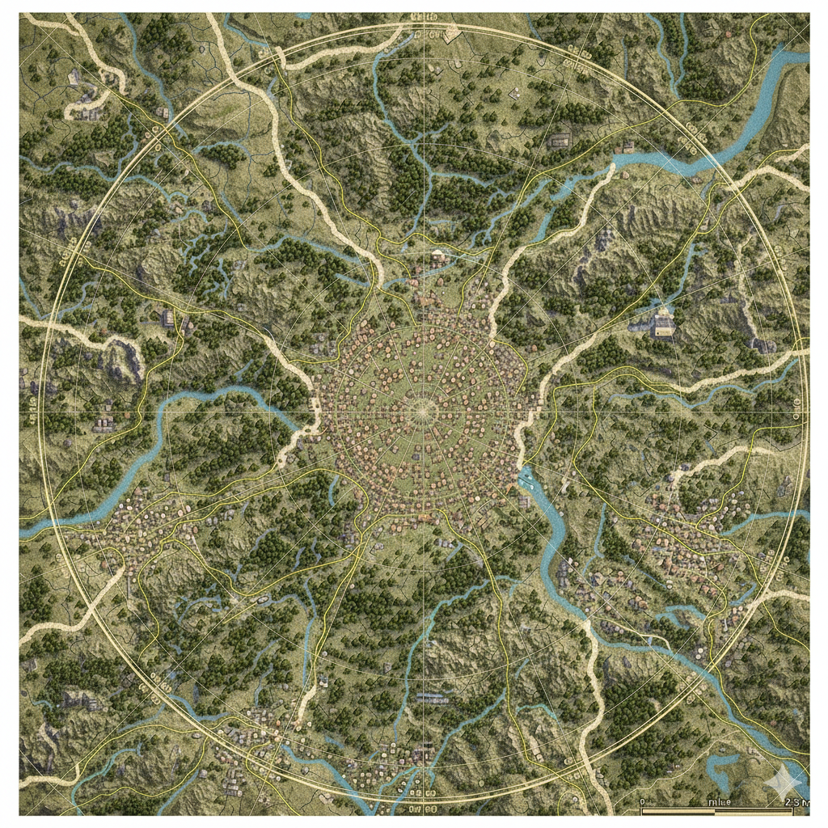

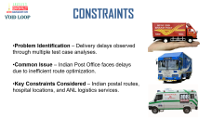
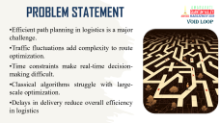
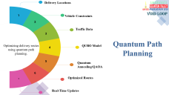
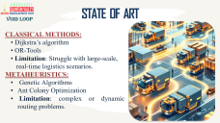
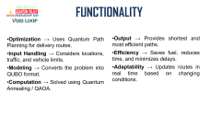
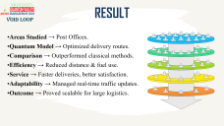
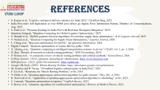
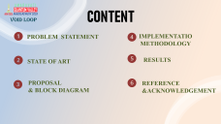

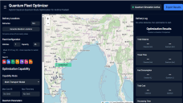


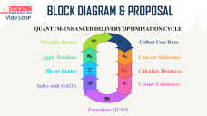
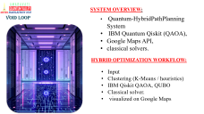
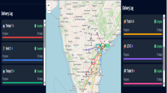

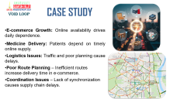
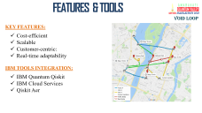
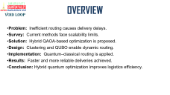

Slide 6






CONTENT
VOID LOOP
PROBLEM STATEMENT
IMPLEMENTATIO
METHODOLOGY
STATE OF ART
RESULTS
PROPOSAL
& BLOCK DIAGRAM
REFERENCE &ACKNOWLEDGEMENT

Slide 7

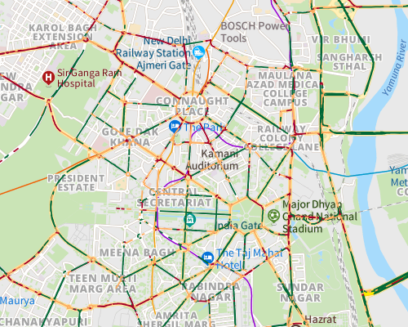
CASE STUDY
VOId LOOP
E-commerce Growth: Online availability drives daily dependence.
Medicine Delivery: Patients depend on timely online supply.
Logistics Issues: Traffic and poor planning cause delays.
Poor Route Planning – Inefficient routes increase delivery time in e-commerce.
Coordination Issues – Lack of synchronization causes supply chain delays.

Slide 8

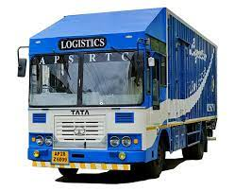
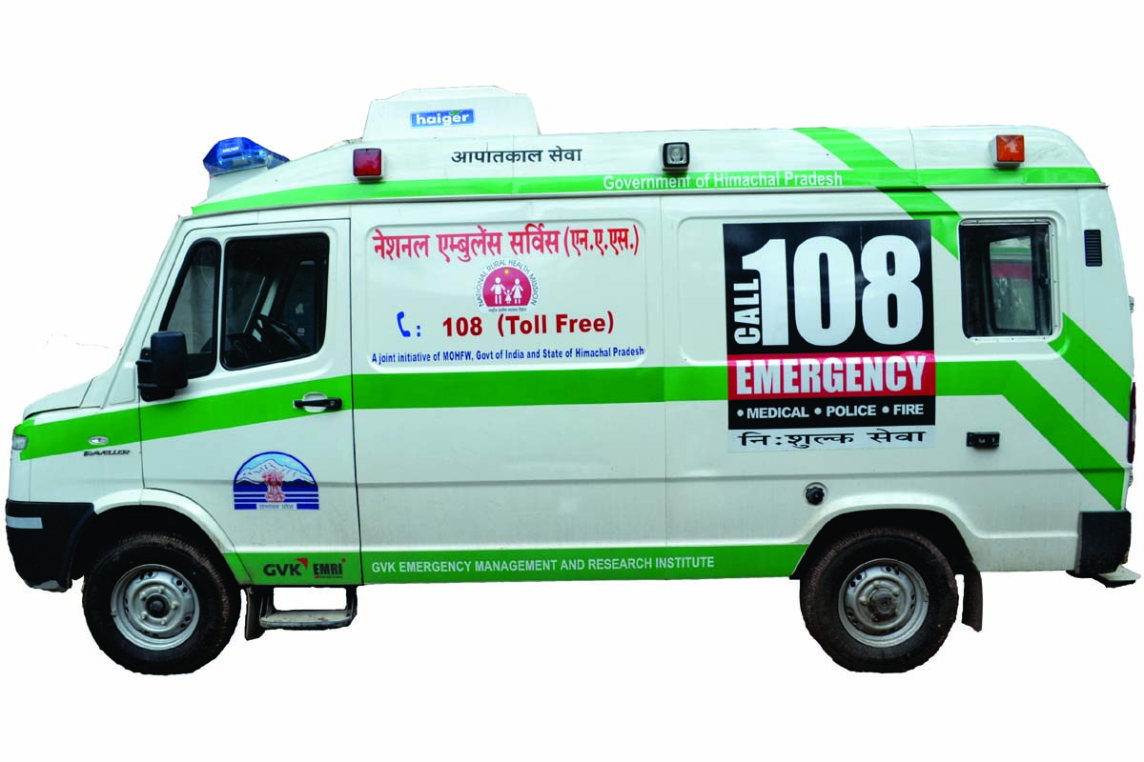
CONSTRAINTS
VOId LOOP
Problem Identification – Delivery delays observed through multiple test case analyses.
Common Issue – Indian Post Office faces delays due to inefficient route optimization..
Key Constraints Considered – Indian postal routes, hospital locations, and ANL logistics services.

Slide 9

PROBLEM STATEMENT
VOID LOOP
Efficient path planning in logistics is a major challenge.
Traffic fluctuations add complexity to route optimization.
Time constraints make real-time decision-making difficult.
Classical algorithms struggle with large-scale optimization.
Delays in delivery reduce overall efficiency in logistics

Slide 10

STATE OF ART
VOID LOOP
CLASSICAL METHODS:
Dijkstra’s algorithm
OR-Tools
Limitation: Struggle with large-scale, real-time logistics scenarios.
METAHEURISTICS:
Genetic Algorithms
Ant Colony Optimization
Limitation: complex or dynamic routing problems.

Slide 11

CUTTING-EDGE TECHNOLOGY
QUANTUM APPROACHES:
QUBO
Quantum Annealing,
QAOA
IBM Quantum Qiskit
RESEARCH GAP:
Integration issue
Open challenge.
Hybrid Limitation
Scalability Issues

Slide 12
BLOCK DIAGRAM & PROPOSAL
VOID LOOP
QUANTUM-ENHANCED DELIVERY OPTIMIZATION CYCLE
Visualize Routes
Collect User Data
Display optimized routes on a map
Gather delivery addresses and preferences
Apply Penalties
Convert Addresses
Adjust routes based on time-window satisfaction
Use Geocoding API for coordinates
Merge Routes
Calculate Distances
Solve with QAOA
Cluster Customers
Optimize routes using quantum algorithms
Formulate QUBO
Convert subgroups into QUBO problems

Slide 13

SYSTEM OVERVIEW:
Quantum-HybridPathPlanning System
IBM Quantum Qiskit (QAOA),
Google Maps API,
classical solvers.
VOID LOOP
HYBRID OPTIMIZATION WORKFLOW:
Input
Clustering (K-Means / heuristics)
IBM Qiskit QAOA, QUBO
Classical solver.
visualized on Google Maps

Slide 14
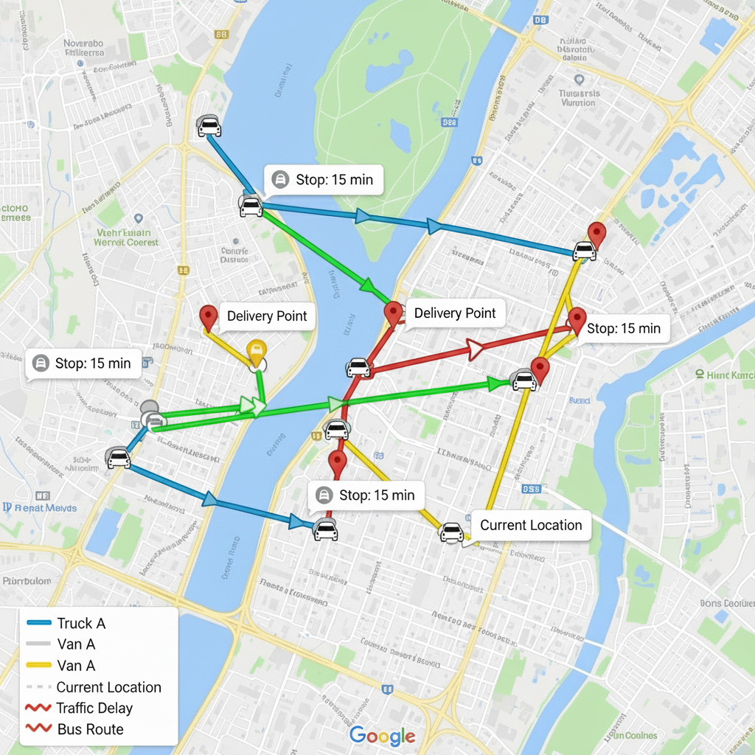
FEATURES & TOOLS
VOID LOOP
KEY FEATURES:
Cost-efficient
Scalable
Customer-centric:
Real-time adaptability
IBM TOOLS INTEGRATION:
IBM Quantum Qiskit
IBM Cloud Services
Qiskit Aer

Slide 15
FUNCTIONALITY
VOID LOOP
Optimization → Uses Quantum Path Planning for delivery routes.
Input Handling → Considers locations, traffic, and vehicle limits.
Modeling → Converts the problem into QUBO format.
Computation → Solved using Quantum Annealing / QAOA.
Output → Provides shortest and most efficient paths.
Efficiency → Saves fuel, reduces time, and minimizes delays.
Adaptability → Updates routes in real time based on changing conditions.

Slide 16
Delivery Locations
VOID LOOP
1
Vehicle Constraints
2
Traffic Data
3
Quantum Path Planning
Optimizing delivery routes using quantum path planning.
QUBO Model
4
5
Quantum Annealing/QAOA
6
Optimized Routes
7
Real-Time Updates

Slide 17
RESULT
VOID LOOP
Areas Studied → Post Offices.
Quantum Model → Optimized delivery routes.
Comparison → Outperformed classical methods.
Efficiency → Reduced distance & fuel use.
Service → Faster deliveries, better satisfaction.
Adaptability → Managed real-time traffic updates.
Outcome → Proved scalable for large logistics.

Slide 18
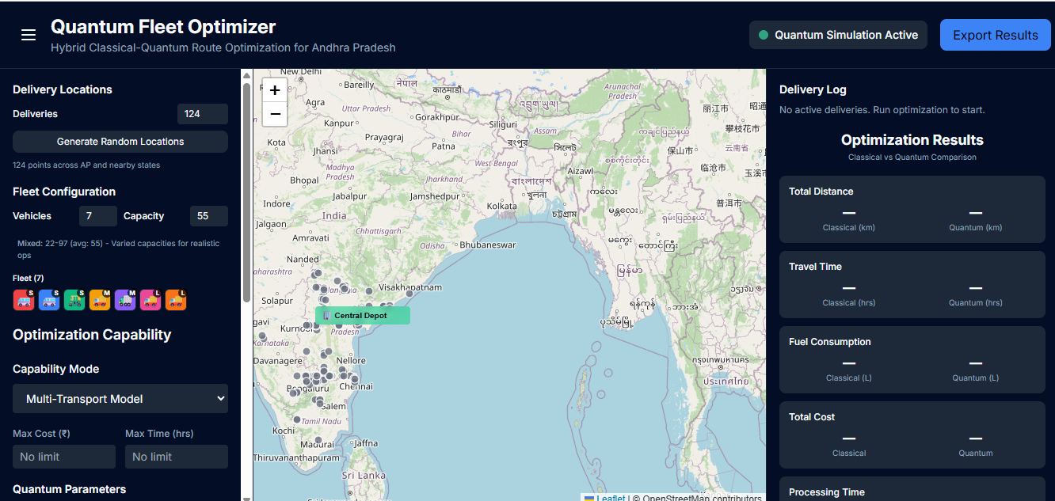

Slide 19
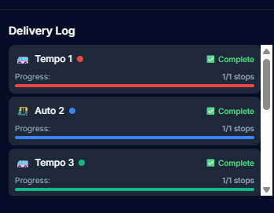
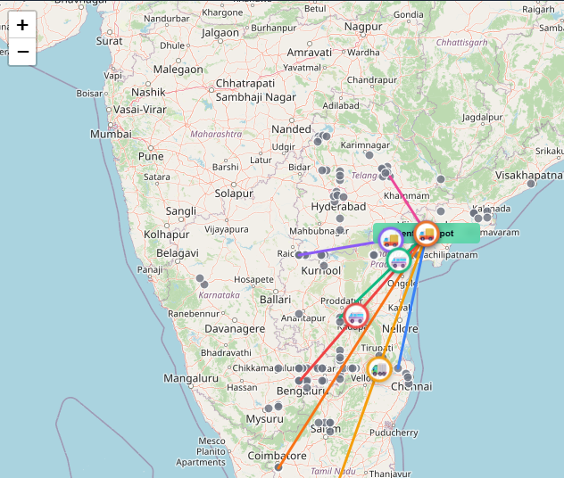
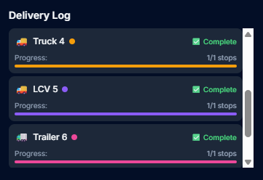

Slide 20
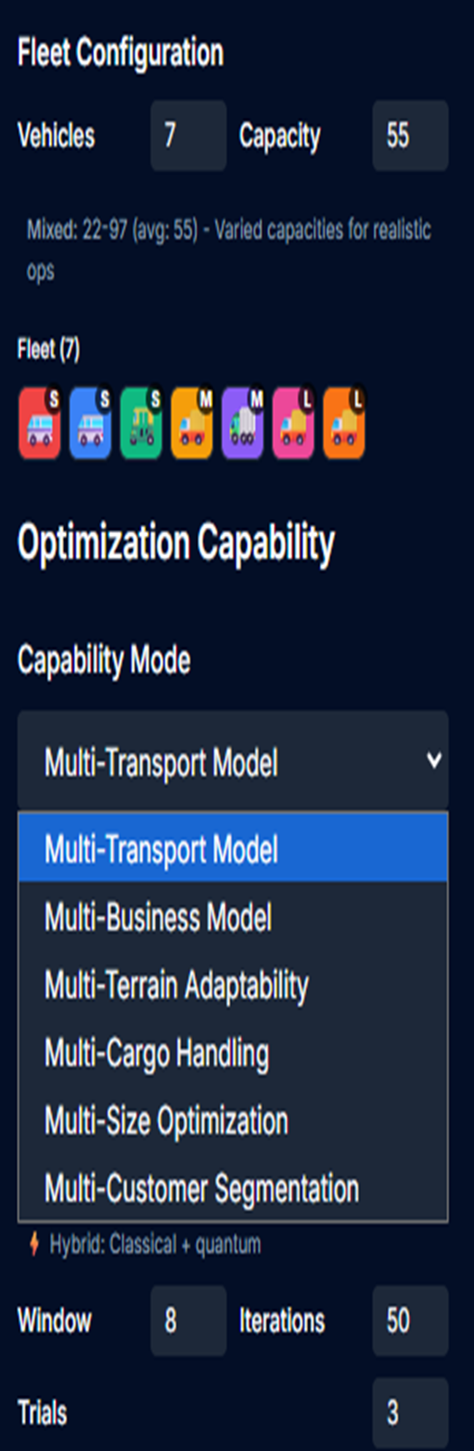
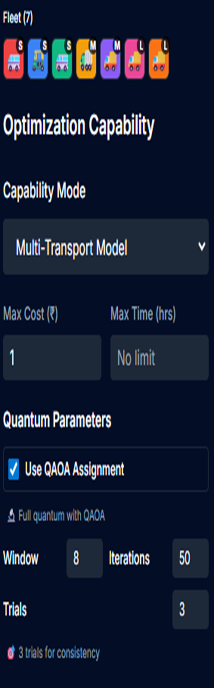
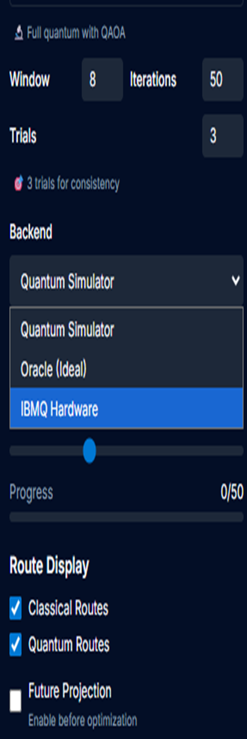
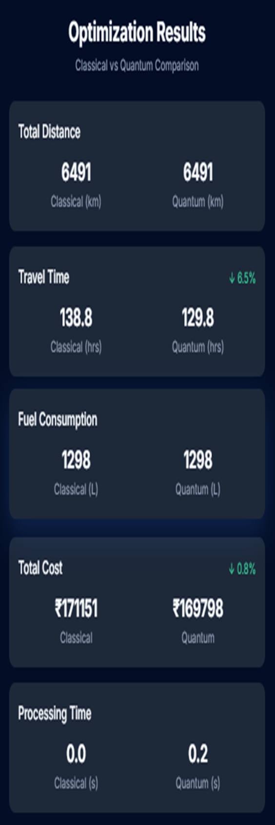

Slide 21
OVERVIEW
VOID LOOP
Problem: Inefficient routing causes delivery delays.
Survey: Current methods face scalability limits.
Solution: Hybrid QAOA-based optimization is proposed.
Design: Clustering and QUBO enable dynamic routing.
Implementation: Quantum–classical routing is applied.
Results: Faster and more reliable deliveries achieved.
Conclusion: Hybrid quantum optimization improves logistics efficiency.

Slide 22
REFERENCES
VOID LOOP
S. Kumar et al., “Logistics and parcel delivery statistics for India 2025,” ClickPost Blog, 2025.
India Post nears full digitization as over 86000 post offices go digital, Press Information Bureau, Ministry of Communications, Aug. 2025.
S. Patel et al., “Dynamic Routing for India Post with Real-time Disruption Mitigation,” 2025.
Quantum Zeitgeist, “Quantum Computing for Global Logistics Optimization,” 2025.
S. Mandal et al., “Hybrid quantum-classical algorithms for real-time supply chain optimization,” AI & Logistics Journal, 2025
V. Ventura et al., “Quantum Computing for Supply Chain Optimization,” Logistics Journal, 2024.
L. Cheng et al., “Bayesian optimization for QAOA,” npj Quantum Information, 2024.
Digital Catapult, “Quantum optimization of courier delivery paths,” 2024.
X. Zhuang et al., “Quantum computing in intelligent transportation systems: A survey,” CHAIN, vol. 1, no. 2, 2024.
D. Hao, “Review of research on vehicle routing problems,” SPIE Proceedings, 2024.
P. Nielsen et al., “A systematic review of vehicle routing problems and solution methods,” ScienceDirect, 2024.
D-Wave Systems. (2023). Quantum Annealing for Optimization. https://www.dwavesys.com
IBM Quantum. (2023). Qiskit Documentation. https://qiskit.org
Google OR-Tools. (2023). Vehicle Routing Problem. https://developers.google.com/optimization.
M. Srinivas and B. Varma, “AI-enabled logistics enhancements in India Post,” 2023.
F. Liu et al., “Heuristics for Vehicle Routing Problem,” arXiv, 2023.
Y. Deller et al., “Quantum approximate optimization algorithm for qudit systems,” Phys. Rev. A, 2023.
K. Kurowski et al., “Application of quantum approximate optimization algorithm to scheduling,” arXiv, 2023.
C. Lennard, “Quantum optimization in logistics,” LogTech Review, 2023.
S. Bravyi et al., “Quantum algorithms for combinatorial optimization,” Reviews of Modern Physics, 2023.

Slide 23
Acknowledgment
VOID LOOP
We would like to express our heartfelt gratitude to the HONOURABLE CHIEF GUEST, CHIEF MINISTER OF ANDHRA PRADESH, SRI NARA CHANDRABABU NAIDU GARU, and to SRI NARA LOKESH GARU for conducting the hackathon and for motivating students to explore and innovate along the path of Quantum Technologies.
We are especially grateful to our SPOC, DR. J. SIVA RAMA KRISHNA, for his invaluable guidance, constructive feedback, and constant support, which have been instrumental in our learning journey.
We also sincerely thank the ORGANIZERS for providing us with this great opportunity and for their continuous encouragement throughout the event

